Slide 1
Data Type 3: temporal snapshot model
Xiaowei Jia
University of Pittsburgh
Xiaowei@pitt.edu

Slide 2
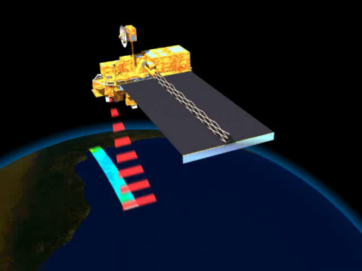
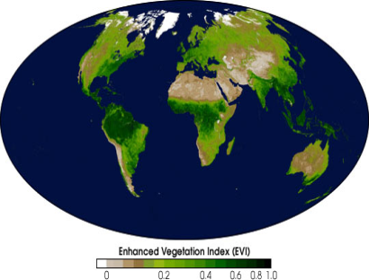
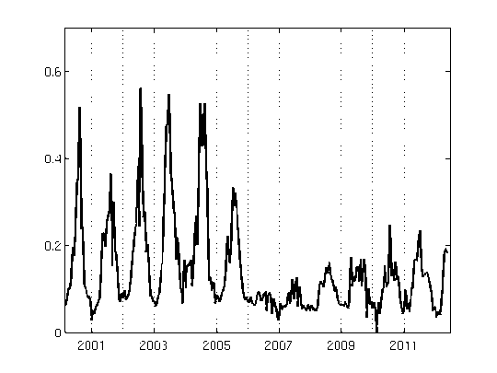
Big Data in Remote Sensing – temporal snapshot model
Different indices measures the surface biomass, temperature, soil conditions, air quality, etc.
This time series of indices captures temporal dynamics
MODIS covers ~ 5 billion locations globally at 250m resolution daily since Feb 2000.
Data | Type | Coverage | Spatial Resolution | Temporal Resolution | Spectral Resolution | Duration | Availability
MODIS | Multispectral | Global | 250 m | Daily | 7 | 2000 - present | Public
LANDSAT | Multispectral | Global | 30 m | 16 days | 7 | 1972 - present | Public
Hyperion | Hyperspectral | Regional | 30 m | 16 days | 220 | 2001 - present | Private
Sentinal - 1 | Radar | Global | 5 m | 12 days | - | 2014 - present | Public
Quickbird | Multispectral | Global | 2.16 m | 2 to 12 days | 4 | 2001 - 2014 | Private
WorldView - 1 | Panchromatic | Global | 50 cm | 6 days | 1 | 2007 - present | Private

Slide 3
Remote Sensing for Health
How is climate change related to important health problems
New opportunities to use machine learning and data mining methods to extract important characteristics of the Earth system that are indicative of disease infection
Use remote sensing to track changes before and after the pandemic

Slide 4
Outline
Monitoring the spatio-temporal pattern of disease infections using remote sensing data
Potential of using remote sensing data in monitoring large-scale changes
RS for studying effects of climate change on epidemics
RS for studying impacts of the pandemic
Future directions

Slide 5
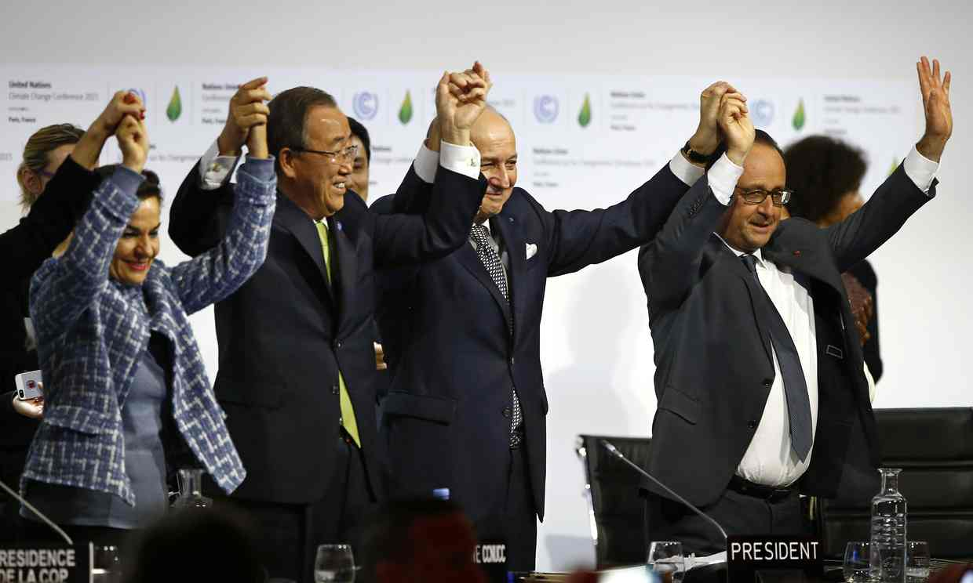
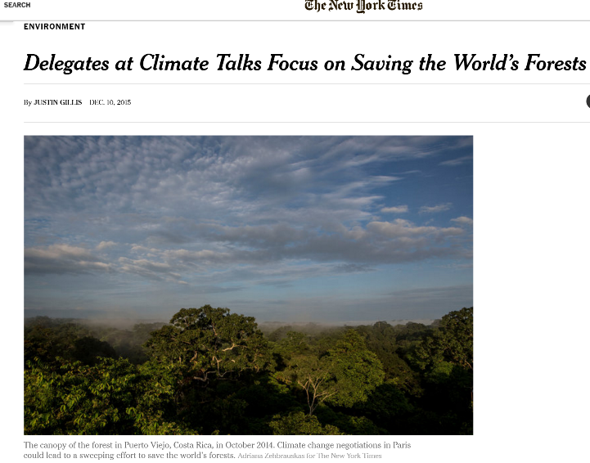
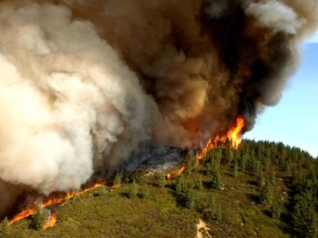
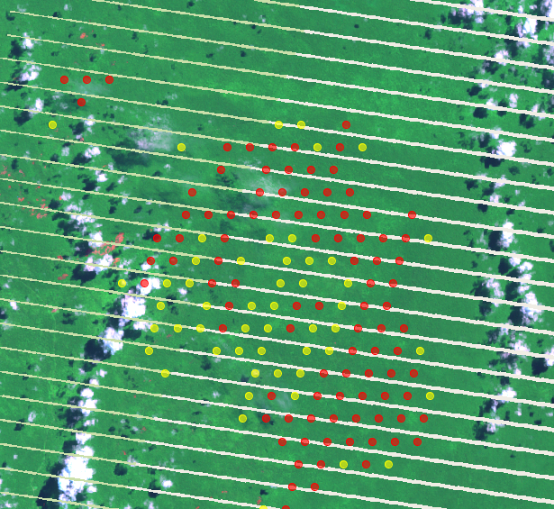
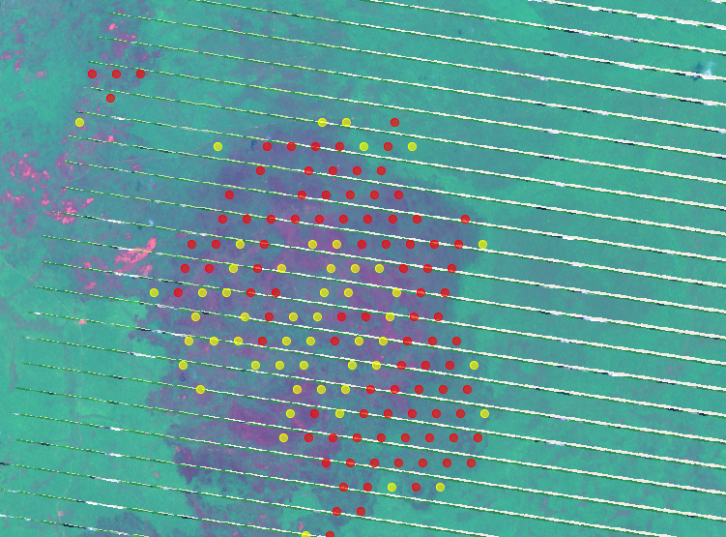
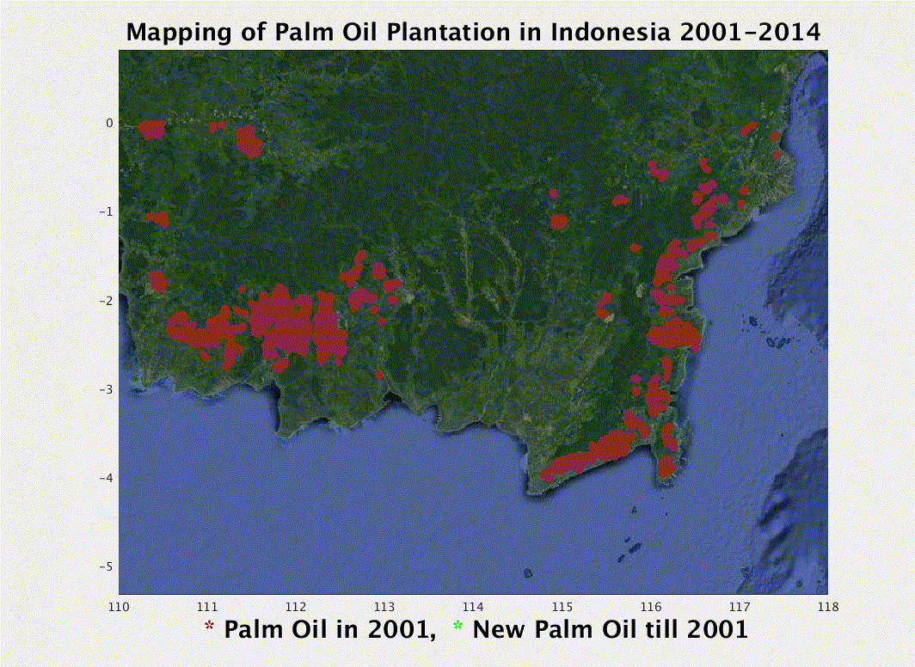
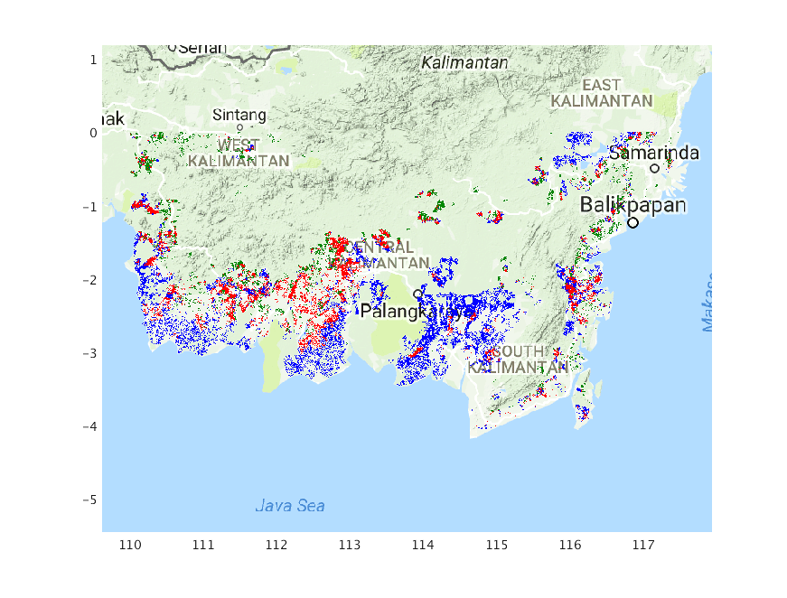
Example: Global Forest Fires Mapping
Monitoring fires is important for climate change impact
A record number of more than 150 countries signed the landmark agreement to tackle climate change at a ceremony at UN headquarters on 22 April, 2016.
Jia et al. 2020
Mithal et al. 2017
Plantation maps
Fire propagation
Before Fire Event
After Fire Event
Mithal et al. Rapt: Rare class prediction in absence of true labels. TKDE, 2017.
Jia et al. Automated plantation mapping in southeast asia using modis data and imperfect visual annotations.Remote Sensing. 2020
Notes:
Researchers interested – 1. spatial-temporal nature, 2. global coverage, 3. unique challenges
Government company interested, 1. solve important problems related to climate changes, food and water security

Slide 6
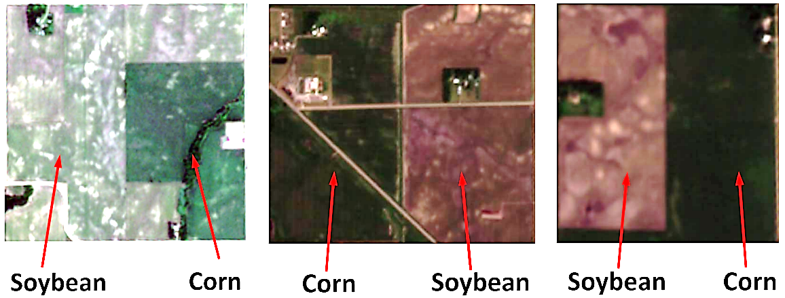
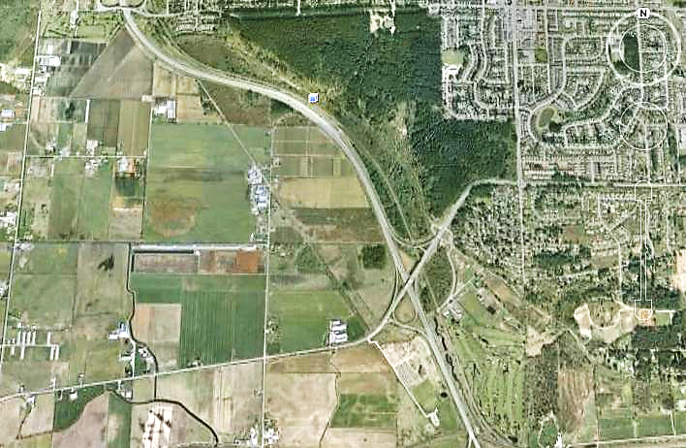
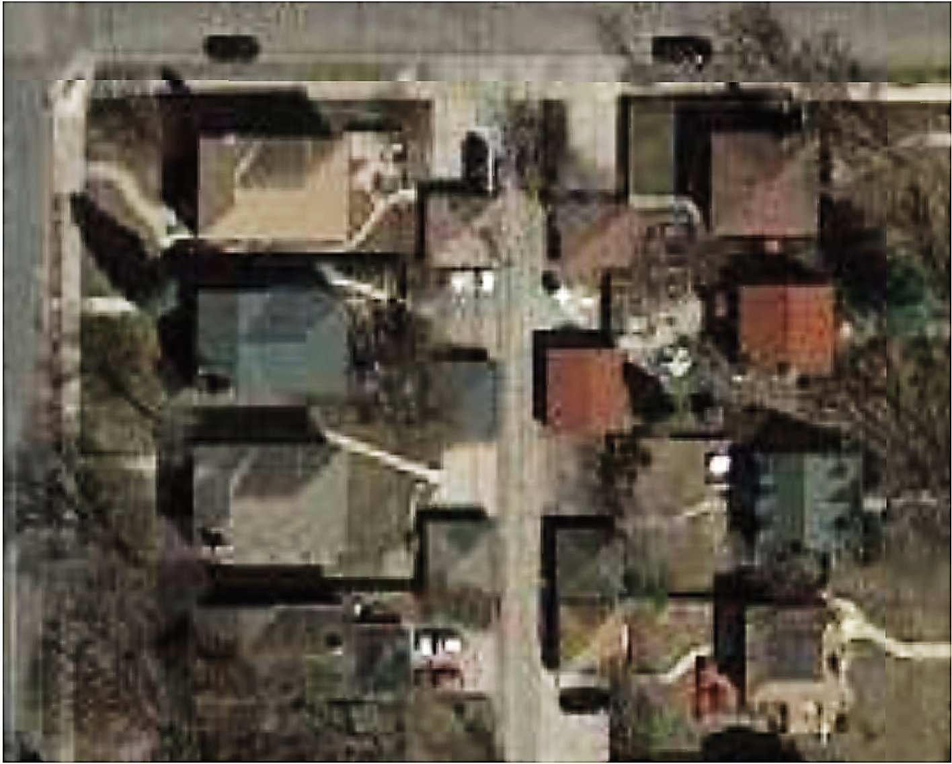
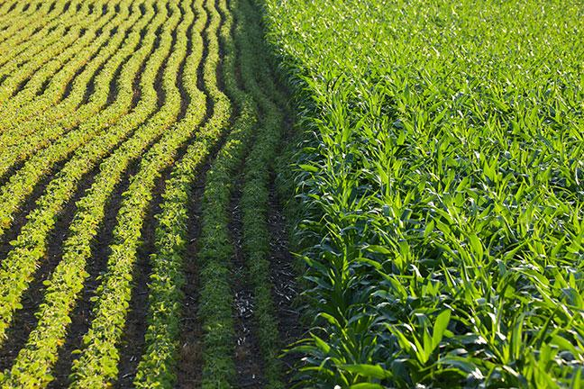
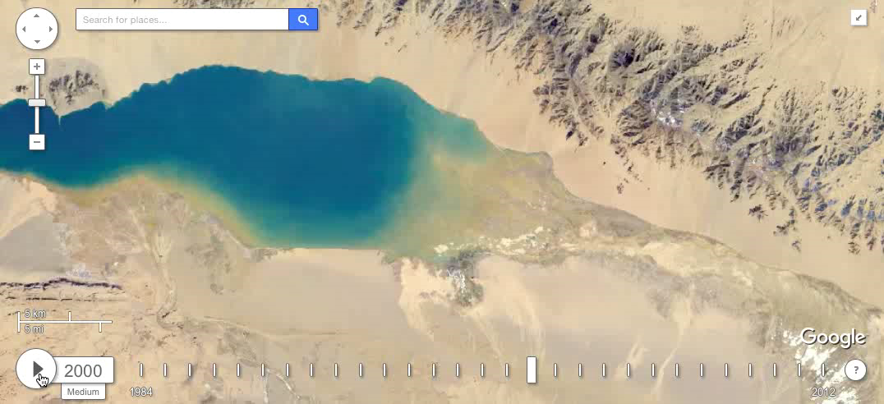
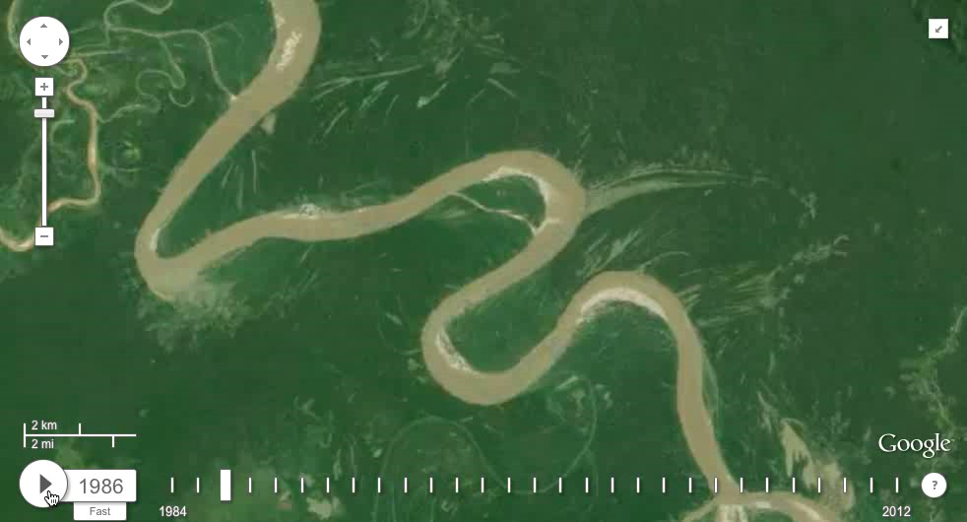
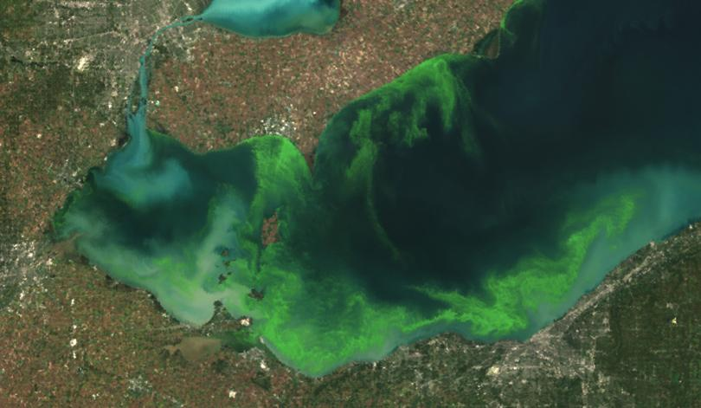
Example: Land Use and Land Cover Study
Agriculture
Interpretability based on phenology:
Urbanization
Cover crop map
Redwood Minnesota
Corn
Soybean
Water monitoring
Water dynamics
Water quality
Notes:
More text details here: Remote sensing: ground and atmosphere

Slide 7
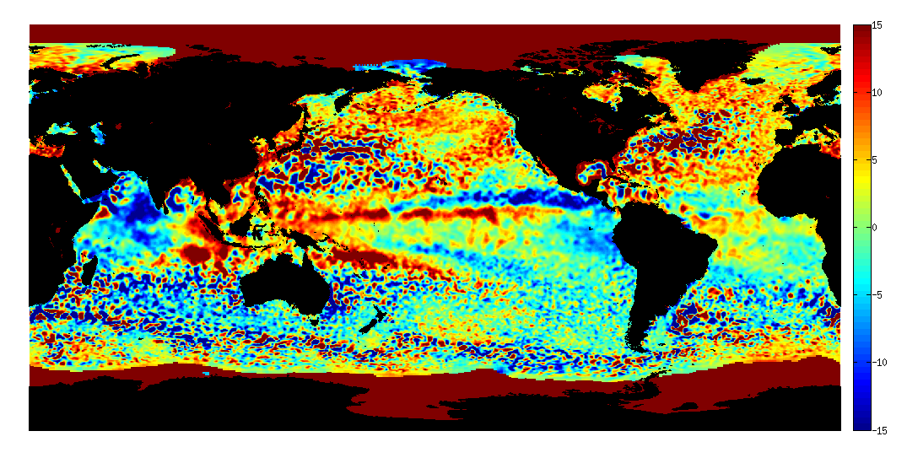
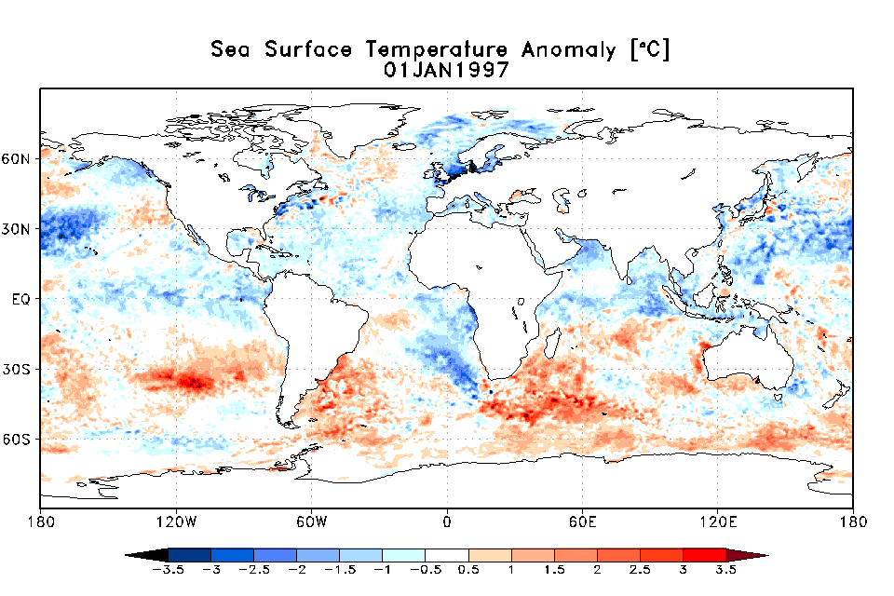
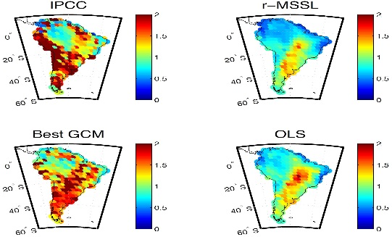
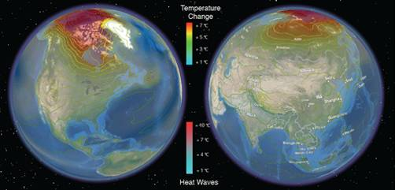
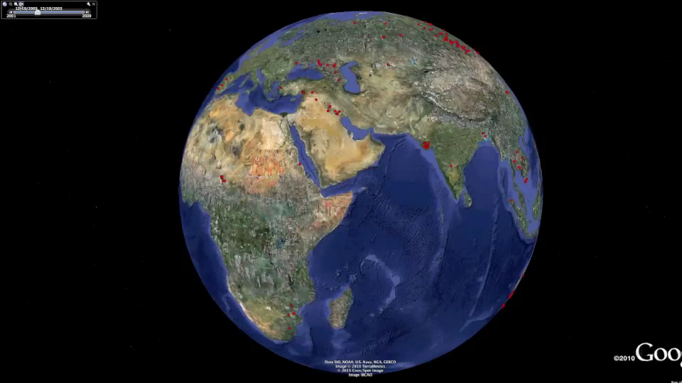
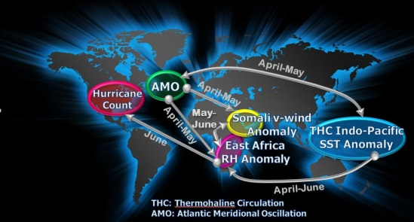
Understanding Climate Change: A Data-driven Approach
Research Highlights
Pattern Mining:
Monitoring Ocean Eddies
Spatio-temporal pattern mining using novel multiple object tracking algorithms
Created an open source data base of 20+ years of eddies and eddy tracks
Network Analysis:
Climate Teleconnections
Scalable method for discovering related graph regions
Discovery of novel climate teleconnections
Also applicable in analyzing brain fMRI data
Sparse Predictive Modeling:
Precipitation Downscaling
Hierarchical sparse regression and multi-task learning with spatial smoothing
Regional climate predictions from global observations
Extremes and Uncertainty: Heat waves, heavy rainfall
Extreme value theory in space-time and dependence of extremes on covariates
Spatiotemporal trends in extremes and physics-guided uncertainty quantification
Change Detection:
Monitoring Ecosystem Distrubances
Robust scoring techniques for identifying diverse changes in spatio-temporal data
Created a comprehensive catalogue of global changes in surface water and vegetation, e.g. fires and deforestation.
Relationship mining:
Seasonal hurricane activity
Statistical method for automatic inference of modulating networks
Discovery of key factors and mechanisms modulating hurricane variability
http://climatechange.cs.umn.edu/

Slide 8
Outline
Monitoring the spatio-temporal pattern of disease infections using remote sensing data
Potential of using remote sensing data in monitoring large-scale changes
RS for studying effects of climate change on epidemics
RS for studying impacts of the pandemic
Future directions

Slide 9
Effects of climate change on epidemics
Cryptosporidiosis (Milwaukee, Wisconsin, USA, in 1993) and Escherichia coli O157 infection (Walkerton, Ontario, Canada, in 2000): Both events were preceded by heavy rains; had highly concentrated sources of pathogens in the form of untreated sewage and animal waste, respectively. (Wilson et al.)
Wilson ME et al. Disease in evolution: global changes and emergence of infectious diseases. New York: New York Academy of Sciences; 1994
Notes:
Climate change, together with other natural and human-made health stressors, influences human health and disease in numerous ways.
In the U.S., public health can be affected by disruptions of physical, biological, and ecological systems, including disturbances originating here and elsewhere. The health effects of these disruptions include increased respiratory and cardiovascular disease, injuries and premature deaths related to extreme weather events, changes in the prevalence and geographical distribution of
food-, water-borne, vector-borne illnesses and other infectious diseases (respiratory diseases) are related to extreme weather events.
Example
Not everyone is equally at risk. Important considerations include age, economic resources, and location.

Slide 10
Effects of climate change on epidemics
Cryptosporidiosis (Milwaukee, Wisconsin, USA, in 1993) and Escherichia coli O157 infection (Walkerton, Ontario, Canada, in 2000): Both events were preceded by heavy rains; had highly concentrated sources of pathogens in the form of untreated sewage and animal waste, respectively. (Wilson et al.)
Earth observation data can be leveraged to estimate environmental variables that influence the transmission cycle of diseases.
Environmental variables and representative indices
Land covers, sea surface temperature, vegetation indices, precipitation
Feature extraction
Predict
Outbreaks/infection of target diseases
Spatio-temporal data
Wilson ME et al. Disease in evolution: global changes and emergence of infectious diseases. New York: New York Academy of Sciences; 1994
Notes:
Climate change, together with other natural and human-made health stressors, influences human health and disease in numerous ways. Some existing health threats will intensify and new health threats will emerge. Not everyone is equally at risk. Important considerations include age, economic resources, and location.
In the U.S., public health can be affected by disruptions of physical, biological, and ecological systems, including disturbances originating here and elsewhere. The health effects of these disruptions include increased respiratory and cardiovascular disease, injuries and premature deaths related to extreme weather events, changes in the prevalence and geographical distribution of food-, water-borne, vector-borne illnesses and other infectious diseases, and threats to mental health.

Slide 11

Feature extraction from RS data
Objective: extract representative features (vegetation, land surface temperature, atmospheric moisture and rainfall indices) from satellite imagery
Domain knowledge-based extraction from multiple channels (e.g., NDVI, Land Surface Temperature Indices, Moisture Indices)
For example, live green plants appear relatively bright in the near-infrared while clouds and snow tend to be rather bright in the red (as well as other visible wavelengths) and quite dark in the near-infrared
Traditional ML approaches, spatio-temporal data mining approaches.
$$NDVI=\frac{NIR−Red}{NIR+Red}$$

Slide 12
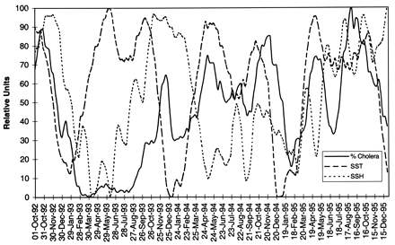
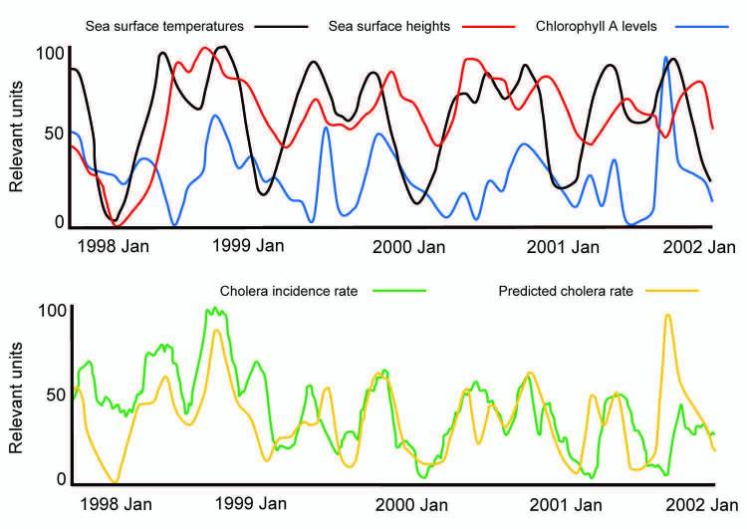
Use RS to predict cholera outbreaks
Motivation: Flooding is the most frequent natural weather disaster (30%–46% of natural disasters in 2004–2005), affecting >70 million persons worldwide each year.
Lobitz et al. extract sea surface temperature and sea surface height from satellite data, and then use them as input to statistical model to predict Cholera cases in Bangladesh.
Ford et al. use sea surface temperature, sea surface height, and chlorophyll A levels to cholera outbreaks in South America.
Can be used for other diseases associated with floods such as diarrhea, typhoid, hepatitis (jaundice), and leptospirosis.
Lobitz et al.
Ford et al.
Lobitz et al. Climate and infectious disease: Use of remote sensing for detection of Vibrio cholerae by indirect measurement. PNAS. 2000
Ford et al. Using Satellite Images of Environmental Changes to Predict Infectious Disease Outbreaks. Emerg Infect Dis. 2009
Notes:
Knowing when an outbreak is likely to occur can inform public health workers to stress basic hygiene and sanitation and to implement simple mitigation efforts such as filtration of water with sari cloth, which in some areas is credited with reducing deaths from cholera by >50%
It has long been known that cholera outbreaks can be initiated when Vibrio cholerae, the bacterium that causes cholera, is present in drinking water in sufficient numbers to constitute an infective dose, if ingested by humans.
Although these environmental parameters have routinely been measured by using water samples collected aboard research ships, the available data sets are sparse and infrequent.
Lobitz: annual biomodal cycle. cholera outbreaks showed a statistically significant association with this cycle because plankton blooms depend on warm ocean temperatures
Imperfect: rates of cholera were much higher than predicted in January 1998 and January 1999, yet many of the predicted peaks closely aligned with actual incidence

Slide 13
RS research for vector-borne disease
Objective: Study the spread of mosquito-borne diseases, including Malaria, Dengue, West Nile Virus
Input:
1) environmental/climate variables (e.g., air temperature, soil temperature, SST, precip, NDVI, EVI),
2)non-environmental variables: Population density (estimated from the intensity of nighttime light), running water, hygienic services, etc.
Output labels: epidemiological data (disease incidence, prevalence or case, mortality data)
Modeling approaches:
Simple regression models
Statistical models: ARIMA, spatial statistics
Probabilistic graphical models
ML methods (SVM, ANN, and ensemble approaches)
Parselia et al. Satellite Earth Observation Data in Epidemiological Modeling of Malaria, Dengue and West Nile Virus: A Scoping Review. Remote Sensing. 2019
Notes:
Limitations: 1. modeling approaches are simple, 2. extract predictors based on domain knowledge, deep learning may be able to automatically extract useful yet discovered features.

Slide 14
Other references
Modeling other climate-related variables
Lin et al. "Mining public datasets for modeling intra-city PM2. 5 concentrations at a fine spatial resolution." In Proceedings of the 25th ACM SIGSPATIAL international conference on advances in geographic information systems, 2017.
Kotchi et al. "Using Earth observation images to inform risk assessment and mapping of climate change related infectious diseases." Canada Communicable Disease Report, 2019.
Study on other diseases
(Vector-borne disease) Ceccato et al. "Data and tools to integrate climate and environmental information into public health." Infectious diseases of poverty, 2018.
(Brucellosis, ANN) Wang et al. A Remote Sensing Data Based Artificial Neural Network Approach for Predicting Climate-Sensitive Infectious Disease Outbreaks: A Case Study of Human Brucellosis, Remote Sensing, 2017
Notes:
, e.g., air quality

Slide 15
Remote sensing for COVID-19
How to use remote sensing in analyzing COVID infection?
Worldview RS data, hotspot zones
Census data, population density, % workers, groundwater well data
GIS-based weighted overlay analysis
Hazard
Vulnerability
Risk assessment and decision making
Kanga et al. Analyzing the Risk to COVID‐19 Infection using Remote Sensing and GIS. Risk Analysis. 2021
Notes:
Worldview data is used for LULC mapping
We hypothesized, hazard in our study as the potential of COVID‐19 posing a danger of exposure to Jaipur's population. We used proximity to hotspots, that is, locations with a high density of confirmed positive COVID‐19 cases, as the hazard and defined four levels of hazard zones in consultation with the municipal and health authorities of Jaipur city; Red zone (0–350 m radius), orange zone (350—700 m), blue zone (700—1,050 m) and green zone (1,050–1,400 m) (Fig. 5(a)). Besides, LULC of the wards was used as a hazard parameter as certain LULC types associate with the high probability of COVID‐19 infections, such as settlements and agriculture, where people gather and get exposed to the virus.
vulnerability refers to the area's susceptibility to COVID‐19 infection due to its demographic, economic, and availability of clean water for sanitation conditions. As far as the current understanding of this pandemic is concerned, densely populated areas, people who do not have access to clean water for frequent sanitation, and people who need to leave their houses for livelihood are significantly more vulnerable. That is why we chose population, population density, well‐density (as water supply data was not available), and percent workers, respectively, as the parameters that make an area more vulnerable to the COVID‐19 infection.

Slide 16
Outline
Monitoring the spatio-temporal pattern of the disease infections using remote sensing data
Potential of using remote sensing data in monitoring large-scale changes
RS for studying effects of climate change on epidemics
RS for studying impacts of the pandemic
Future directions

Slide 17



RS for studying impacts of the pandemic
Spatio-temporal data
Day $t_{1}$
Day $t_{2}$
Day $t_{T}$
Variables related to human activities, economy, etc.
Variables related to human activities, economy, etc.
Variables related to human activities, economy, etc.
. . .
Before pandemic
After pandemic

Slide 18
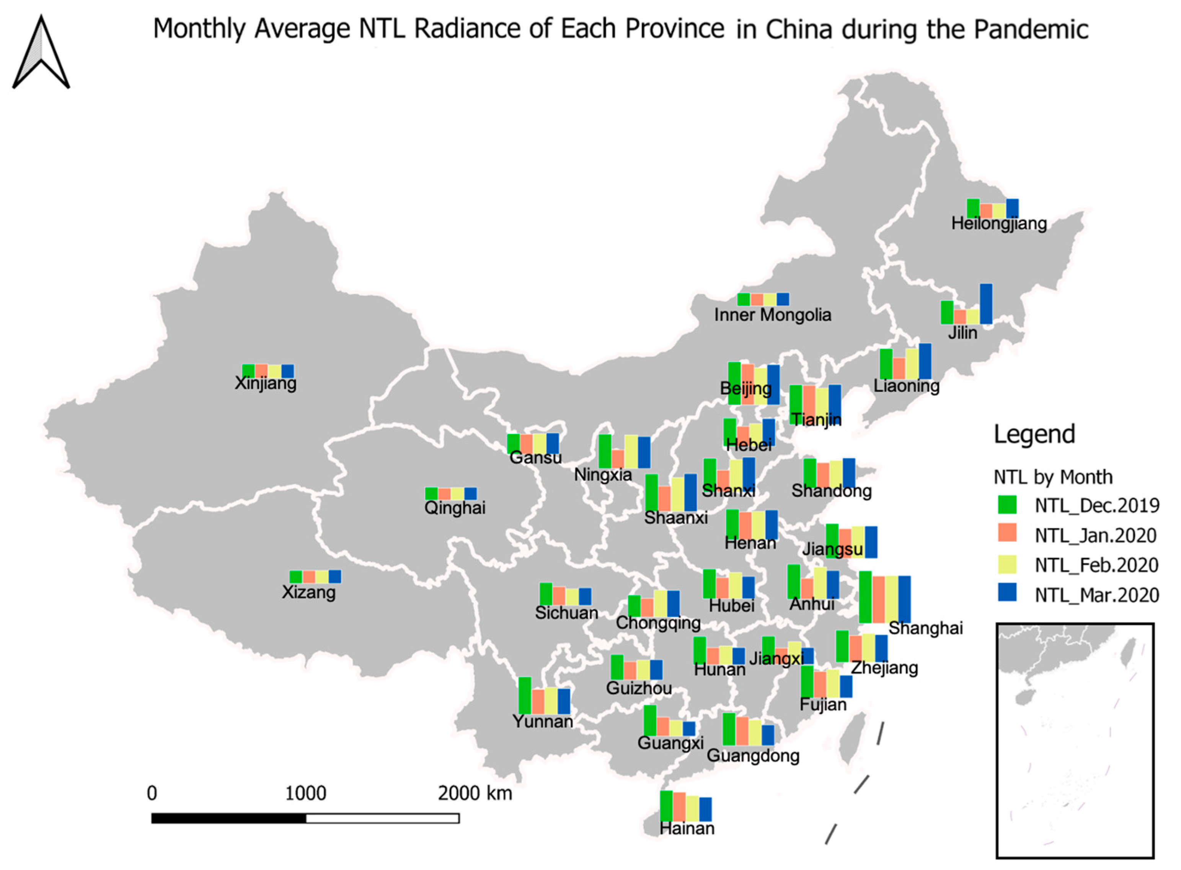
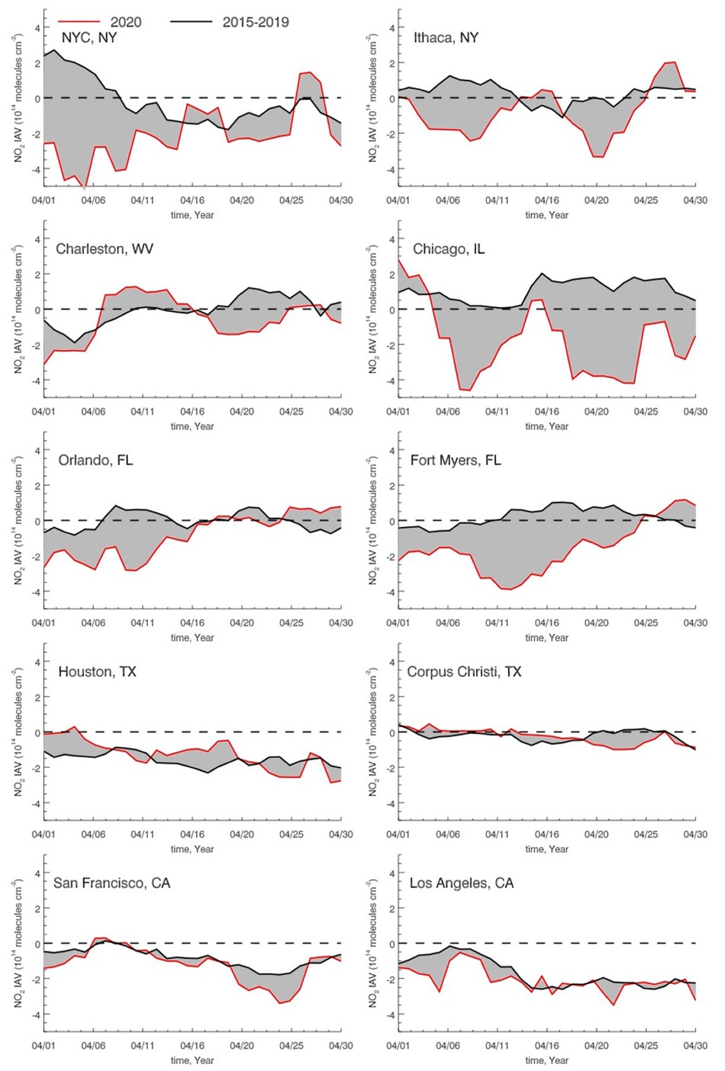
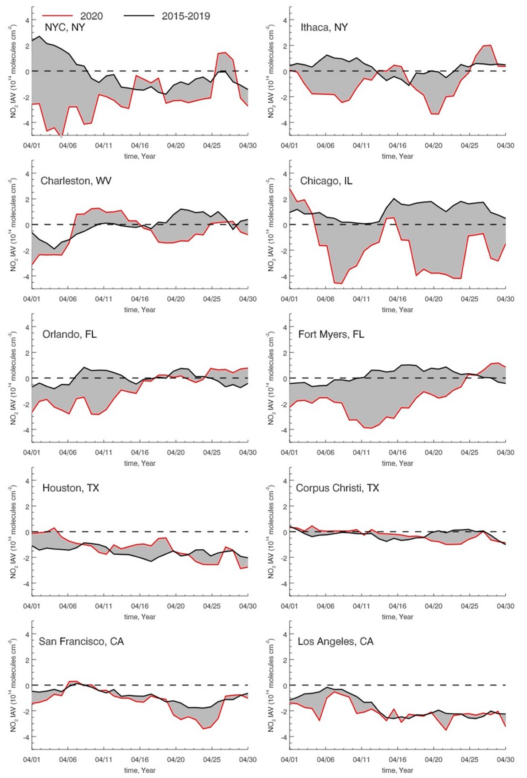
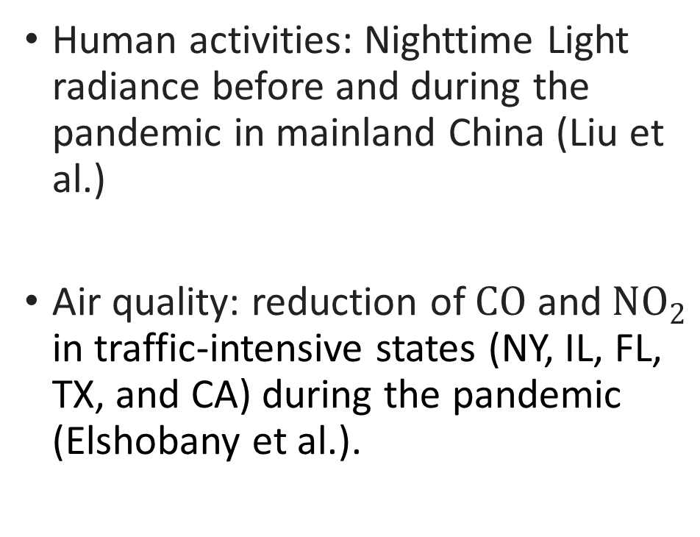
RS for studying impacts of the pandemic
Human activities: Nighttime Light radiance before and during the pandemic in mainland China (Liu et al.)
Air quality: reduction of $CO$ and $NO_{2}$ in traffic-intensive states (NY, IL, FL, TX, and CA) during the pandemic (Elshobany et al.).
Liu et al.
Elshobany et al.
Liu et al. Spatiotemporal Patterns of COVID-19 Impact on Human Activities and Environment in Mainland China Using Nighttime Light and Air Quality Data. Remote Sensing. 2020
Elshobany et al. The Status of Air Quality in the United States During the COVID-19 Pandemic: A Remote Sensing Perspective. Remote Sensing. 2021
Notes:
First study: 1. how human activities are affected by the pandemic, and how they recover over time, 2.which areas are more impacted by the pandemic, which areas are recovering quickly
The ozone monitoring instrument (OMI) is a visual and ultraviolet spectrometer aboard the NASA Aura spacecraft
NO₂ tropospheric column data was obtained from the OMI instrument aboard the Aura satellite
OMI measurements have a daily global coverage.

Slide 19
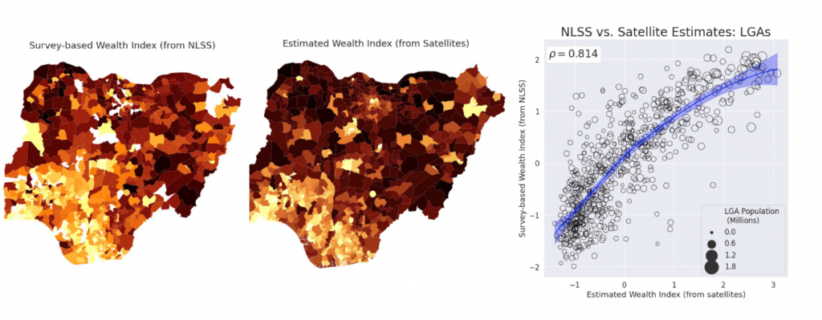
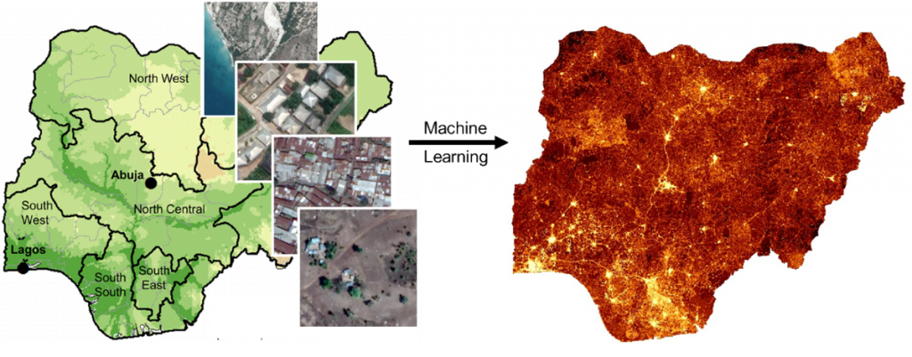
Poverty and Economy
Objective: generate up-to-date poverty maps for Nigeria using satellite imagery.
Other works: Nighttime light for studying declines and recovery in economy (Elvidge et al., 2020)
Maps of wealth index
Gradient boosted regression tree
Blumenstock et al. Using Big Data and machine learning to locate the poor in Nigeria.
Elvidge et al. The Dimming of Lights in China during the COVID-19 Pandemic. Remote Sensing. 2020
Notes:
The COVID-19 crisis is projected to push an additional 10 million people into poverty in Nigeria by 2022; combined with population growth, this could leave more than 100 million Nigerians living below the national poverty line.
ground-truth labels of poverty (from geo-located household surveys)
After constructing these poverty maps, they were carefully validated in Nigeria, using several independent sources of survey data.

Slide 20
Other references
Sussman et al. Can We Measure a COVID-19-Related Slowdown in Atmospheric CO₂ Growth? Sensitivity of Total Carbon Column Observations. Remote Sensing. 2020
Liu et al. Spatiotemporal Patterns of COVID-19 Impact on Human Activities and Environment in Mainland China Using Nighttime Light and Air Quality Data. Remote Sensing. 2020
Li et al. Estimating the Impact of COVID-19 on the PM_{2.5} Levels in China with a Satellite-Driven Machine Learning Model. Remote Sensing. 2021

Slide 21
Outline
Monitoring the spatio-temporal pattern of disease infections spread using remote sensing data
Potential of using remote sensing data in monitoring large-scale changes
RS for studying effects of climate change on epidemics
RS for studying impacts of the pandemic
Future directions

Slide 22
Future opportunities
Advanced machine learning algorithms
Remote sensing datasets
Knowledge-guided machine learning
Notes:
Feature extraction, predictive model

Slide 23
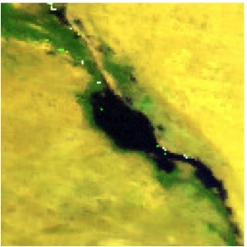
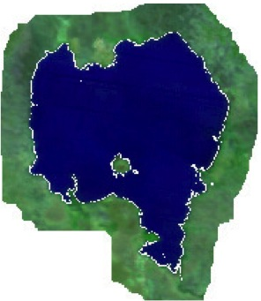
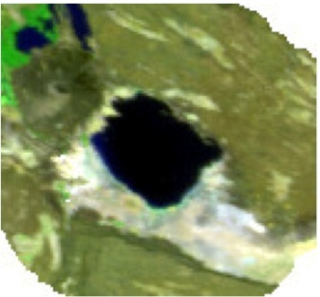
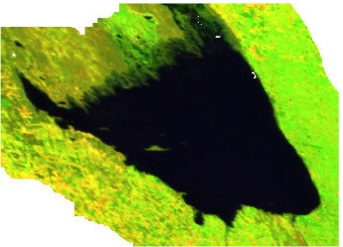
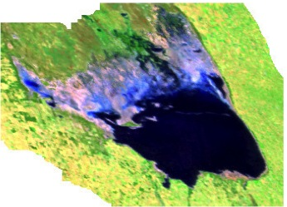

Advanced machine learning algorithms
Major challenges in remote sensing
Spatial and temporal heterogeneity
Limited and noisy ground-truth labels
Noisy data
Advanced ML on RS
Transfer learning (Hu et al.)
Zero-shot learning (Li et al.)
Weakly-supervised learning (Schmitt et al.)
Others (Ghosh et al.)
Great Bitter Lake, Egypt
Lake Tana, Ethiopia
Lake Abbe, Africa
Mar Chiquita Lake, Argentina in 2000 (left) and 2012 (right)
Hu et al. Transferring deep convolu-tional neural networks for the scene classification of high-resolution remote sensing imagery. Remote Sensing, 2015.
Li et al. Zero-shot scene classifi-cation for high spatial resolution remote sensing images. TGRS, 2017.
Schmitt et al. Weaklysupervised semantic segmentation of satellite imagesfor land cover mapping–challenges and opportunities. 2020.
Ghosh et al. Land Cover Mapping in Limited Labels Scenario: A Survey. 2021

Slide 24
Remote sensing datasets
Existing datasets
Sen12MS
DeepGlobe
UC Merced Land Use Dataset
WHU-RS Dataset
Other RS data sources
Data | Type | Coverage | Spatial Resolution | Temporal Resolution | Spectral Resolution | Duration | Availability
MODIS | Multispectral | Global | 250 m | Daily | 7 | 2000 - present | Public
LANDSAT | Multispectral | Global | 30 m | 16 days | 7 | 1972 - present | Public
Hyperion | Hyperspectral | Regional | 30 m | 16 days | 220 | 2001 - present | Private
Sentinal - 1 | Radar | Global | 5 m | 12 days | - | 2014 - present | Public
Sentinel-2 | Multispectral | Global | 10 m | 5-10 days | 12 | 2016 - present | Public
Quickbird | Multispectral | Global | 2.16 m | 2 to 12 days | 4 | 2001 - 2014 | Private
WorldView - 1 | Panchromatic | Global | 50 cm | 6 days | 1 | 2007 - present | Private

Slide 25
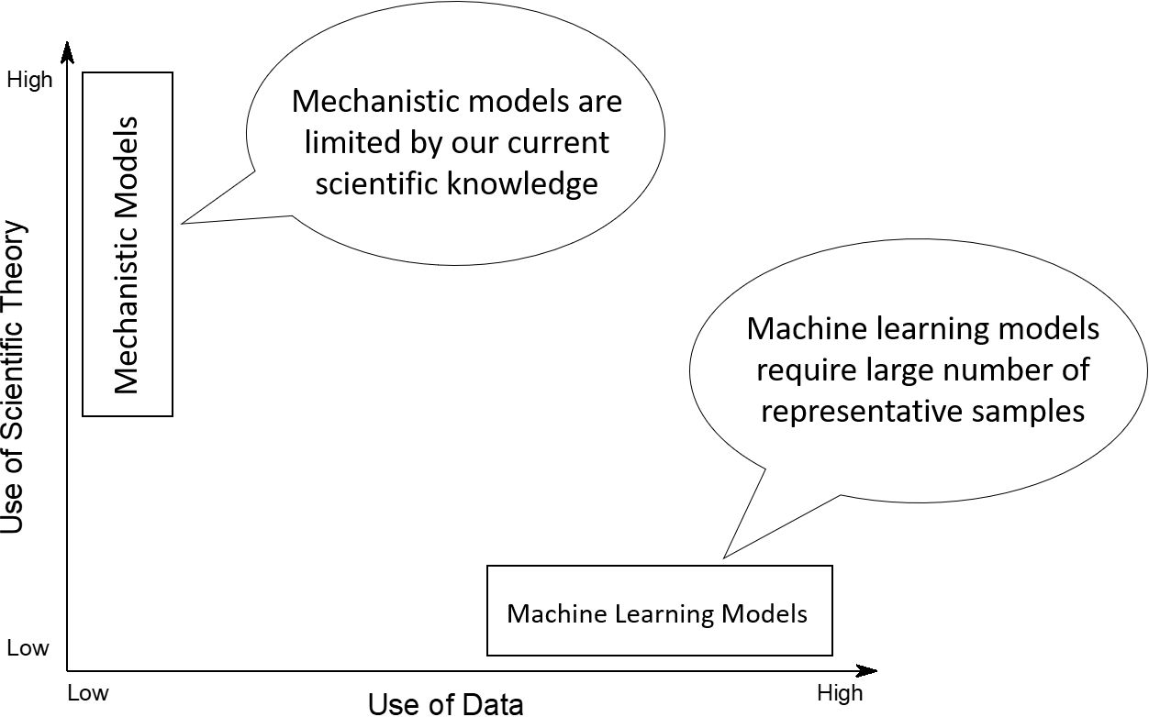
Knowledge-guided machine learning
Mechanistic models have been widely used to study epidemiology, climate changes, traffic systems and economy.
Machine learning models commonly require sufficient training data at desired spatial and temporal resolution.
KGML for leveraging complementary strengths of two types of models. (Willard et al.)
Willard et al. Integrating Physics-Based Modeling with Machine Learning: A Survey. 2020

Slide 26
Q&A

Slide 27
Conclusion
Data type 1: event or process model -- Human routine behavior modeling
Challenges of behavior modeling
Properties of spatiotemporal data
Inverse reinforcement learning
Behavior patterns and epidemic spreads
Data Type 2: temporal change model -- Structural learning on networks
Susceptible-infected-recovered (SIR) – like models
Graph neural networks (GNN) for epidemiology
GNN, SIR, and PDE
Data Type 3: temporal snapshot model -- Remote sensing
Potential of using remote sensing (RS) data in monitoring large-scale changes
RS for studying effects of climate change on epidemics
RS for studying impacts of the pandemic

Slide 28
Thank you

